Slide 1
Using Sleep Time Data from Wearable Sensors for Early Detection of Migraine Attacks
Pekka Siirtola, Heli Koskimäki, Henna Mönttinen and Juha Röning
28. April 2018, Finland

Slide 2
Background
Migraine is a neurological disorder
Associated with severe headache, nausea, vomiting, sound, movement, sensitivity to light etc.
4-72 hours
Five main categories
Medication treatment: preventive and acute
15% of people in the European countries suffers from migraine
Cost 111 billion euros in Europe caused by lost working days
Early detection → reduce cost
Notes:
International Health Society, five main categories:
Migraines without auras
Migraines with auras
Migraines with brainstem auras
Hemiplegic migraines
Reginal migraines
Further into subcategories
Medication: Preventive (daily dose), acute (when symptoms start). Preventive medication is expensive and is avoided for as long as possible.
The early detection of migraine attacks would reduce these costs, as it would shorten the migraine attack by enabling correct timing when taking preventice medication.

Slide 3
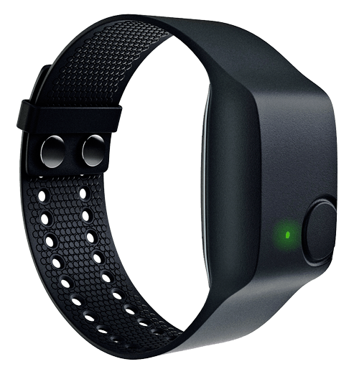
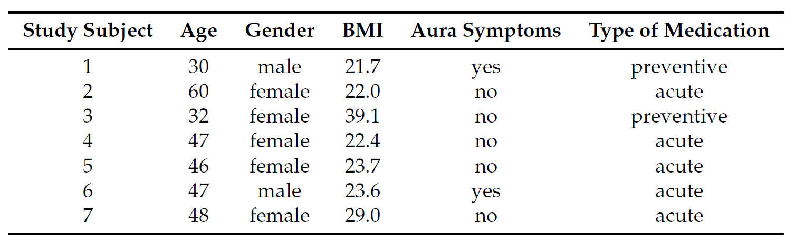
Methods
”The aim of this study is to build reliable recognition models for the early detection of migraine attacks based on sleep time data collected using wearable sensor”
Wrist-worn device to measure 24/7
7 subjects
Empatica E4 sensor
Sleep time data
A diary
Approximately 27 days per subject
Relationship between sleep disturbances
and migraines.
Notes:
E4 measures:
Acceleration
Galvanic skin response
Blood volume pulse
Heart rate
Heart rate variability
Temperature
Related works
Association especially strong between nighttime and early morning migraine attacks.
Related work in the article, which argue for that sleep is associated with migraine and wearable sensors can be used to detect other diseases.
The study stand out from related works by using easy and unexpensive wrist-worn sensor, other studies have used EEG, ECG and more accurate methods.
Subjects
7 subjects (5 women, 2 men, 30-60 years)
Two with aura symptoms and five without, no preventive medication, attacks quite often, which was a criterion for joining the the study, because frequent attacks enabled shorter data collection periods.
Diary: Subjects describe and comment their feelings and symptoms using their own words. The labeling of the sensor data was based on the diary.
Argue for sleep time data
Association
Quality of signals was not good during the daytime, movement seemed to cause disturbances, device needs to be fitted perfectly.

Slide 4
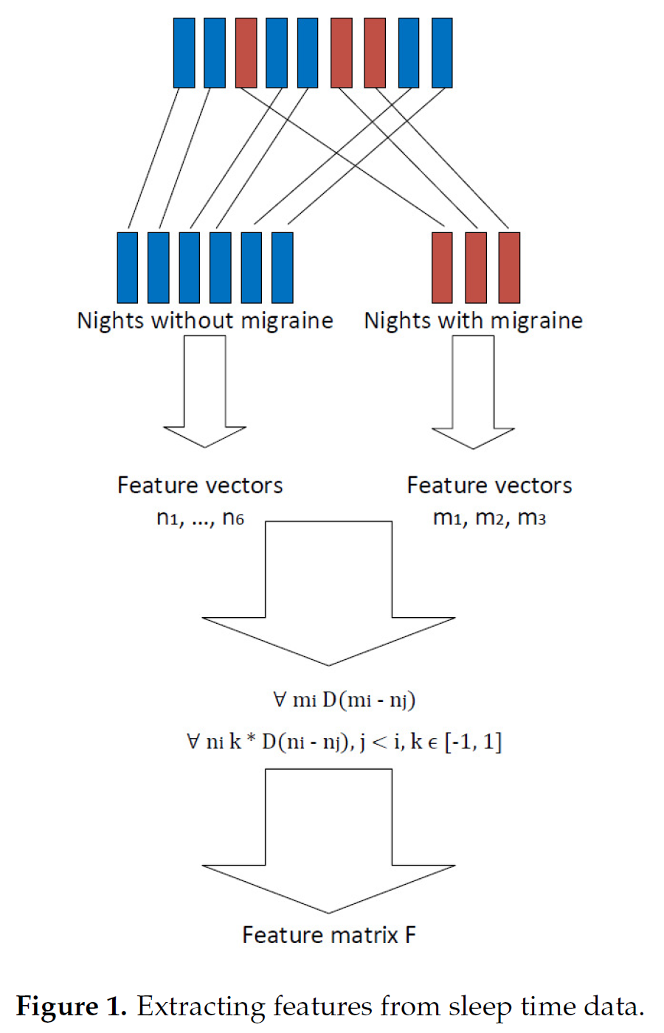
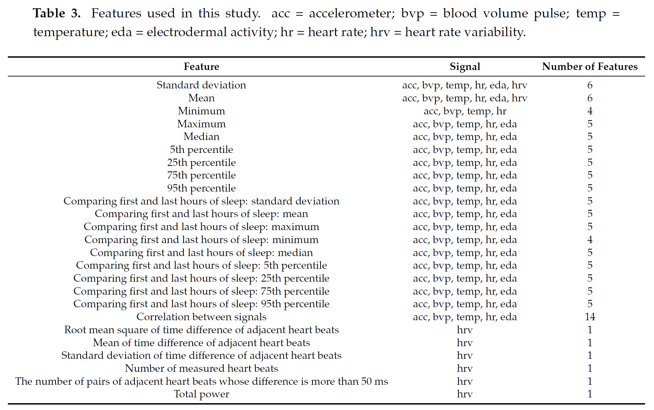
Feature Extraction
110 features from the data of each night
Mostly include time domain features
Notes:
Timestamp for sleeptime was estimated based on when no movements in the 3D accelerometer. Not exact but good approximations. Doesn’t matter because features are extracted from time windows there can be several hours long, small differences didn’t have significant effect on feature values.
Data classes:
Nights before af day without a migraine
Nights before af day with a migraine
Considering one night as one observation compresses data set so much that reliable user-dependent models cannot be built based on it and data is highly UNBALANCED.
To increase the number of observations: Used the difference between night as features
nk= feature vector without attack
ml = feature vector with attack
These are compared, and the remainder (ml – nj) is used as a feature in the classification process, labelled ”migraine day”.
nj are also compared to each other, the remainder (ni – nj) and labelled ”non-migraine day”.
Features
Standard deviation
Mean
Minimum
Maximum
Median
Commonly used to recognize human activities.

Slide 5
Machine learning model
Comparing two classifiers:
Quadratic Discriminant Analysis
Linear Discriminant Analysis
Noise is injected into the data to avoid over-fitting
Training, validation, testing set
Notes:
LDA is used to find a linear combination of features that separate the classes best. The resulting combination may be employed as a linear classifier.
QDA is a similar method but uses quadratic surfaces to seperate classes
Sequential forward selection (SFS) method.
Overfitting is avoided by adding noise into the data using.
Beskriv hvordan data sets er udvalgt.
Four parts for training
One part for validation
In the case of user-independent models, the over-fitting was easily avoided by using leave-one-out cross validation.
Evt. indsæt figur 2

Slide 6
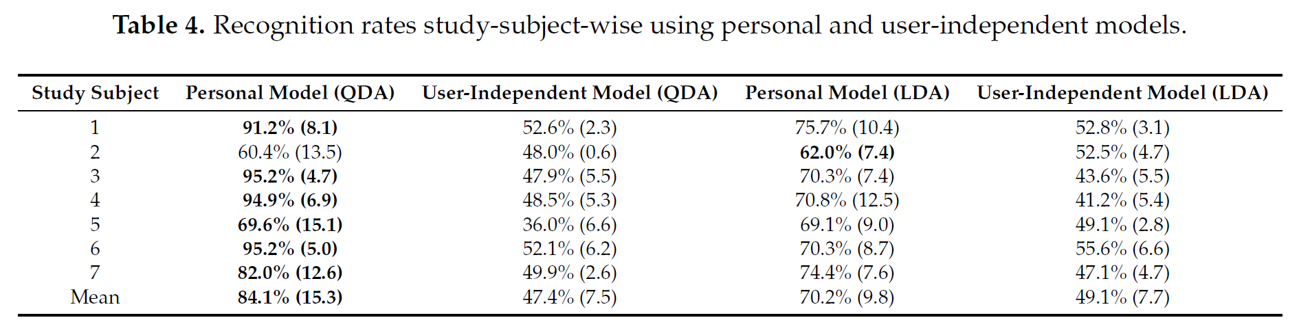
Results
Balanced accuracy for detecting attacks one night prior is over 84%
Balanced accuracy varies greatly between study subjects, which shows how complicated the problem actually is.
QDA vs. LDA
Notes:
Results
The first observation that can be made from the results shown in Table 4 is that the balanced accuracies using user-independent models are much lower than the ones obtained using personal models.
When balanced accuracies of personal models are compared, it can be noted that QDA produces better results than LDA.

Slide 7
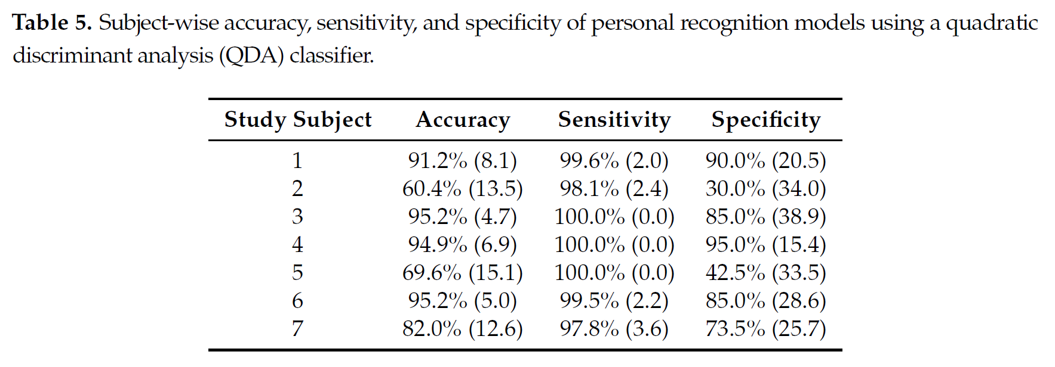
The model doesn’t work for subject 2 and 5
Recognizing non-migraine days with higher accuracy that migraine days
Notes:
The sensitivity and specificity values of Table 5 show that, in the cases of Study Subjects 2 and 5, models do not work at all. In fact, they classify almost all instances into one class.
Personal models are biased towards recognizing non-migraine days with higher accuracy that migraine days, as sensitivity values are higher than specifity values.
High SD values show that recognition accuracies are strongly dependent on which samples are selected in the train and test sets.

Slide 8
Discussion/Conclusions
The migraine attacks cannot be detected reliably beforehand using user-independent models.
Greater user groups
Variation in sensor
One type of migraine attack
Using Personal models indicate that it is possible to early detecting of migraine attacks
Labelling based on the diary
Notes:
Pkt. 1: due to limited number of subjects
Pkt. 2:
Balance accuracy varies between 60.4% and 95.2%.
Large variance in accuracy: difference in the subjects
Studied if some of the false positive results are due to preventive medication.
Most feasible explanation for low recognition rate is the small data set.
Pkt. 3:
Preliminary results, subjects didn’t coer all migraine types.
Wrong labelling, diary
Maybe some migraine types are more difficult to predict than others.

